Slide 1
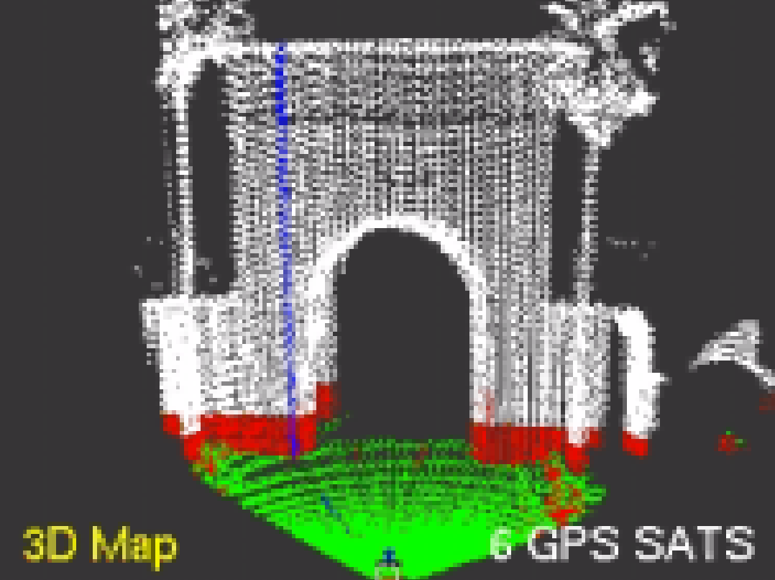
The GraphSLAM Algorithm with Applications to Large-Scale Mapping of Urban Structures
Author: Sebastian Thrun
Presented by: Keith Lewandowski

Slide 2
Outline:
The Concept
Constraint Extraction
Matrix Reduction
Recovering Feature Locations
The Algorithm
GraphSLAM_initialize
GraphSLAM_linearize
GraphSLAM_reduce
GraphSLAM_solve
The Derivations
The Posterior
Taylor Expansion
Constructing the Information Form
Reducing the Information Form
Recovering the Path and the Map

Slide 3
Brief Background/Motivation:
SLAM – Silmultaneous Localization and Mapping
Posterior of the full SLAM problem naturally forms a sparse graph
This graph is a sum of nonlinear quadratic constraints
Optimizing these constraints gives a set of the most likely robot poses
Utilization of previous data to improve current robot pose and map estimation

Slide 4
The Concept
Outline:
Extract a set of soft constraints from the available data
Represent these nonlinear constraints as a sparse graph
Linearize constraints to form sparse "information" matrix
Resolve these constraints into a globally consistent estimate
Reduce information matrix dimensionality
Resolve feature location estimate

Slide 5
Constraint Extraction

Slide 6
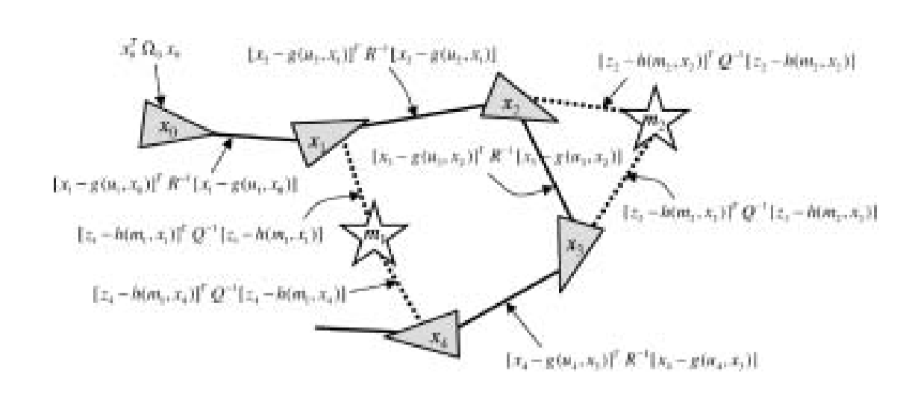
Measurements as Nonlinear Constraints
Goal: to acquire a map, m, and the series of robot poses, x
To find this we want to find the posterior probability over the entire path, instead of just the current pose

Slide 7
Measurements as Nonlinear Constraints
2 Types of Measurement:
Feature Measurement,
Robot Movement,
Analogy: Spring-mass model
Poses and Features are masses
Constraints are springs – stiffness is certainty

Slide 8
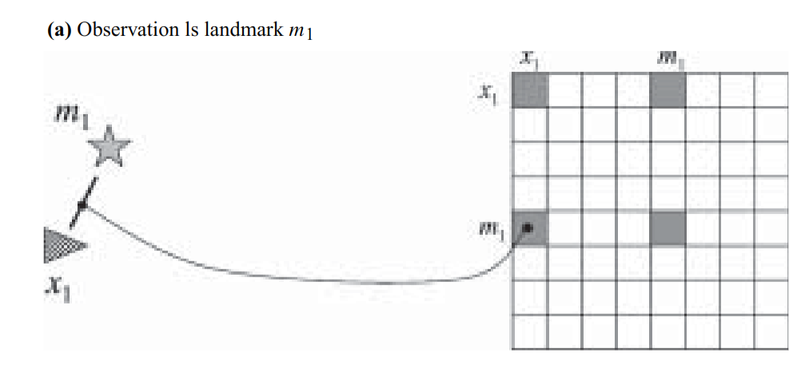
Feature Measurements
Dependance Graph Information Matrix

Slide 9
Feature Measurements
Constraint:
: full measurement at time step t
: measurement beam i at time t
: function that describes how the measurement comes into being
: robot pose at time t
: map feature, j, sensed by measurement i
: measurement gaussian noise, with zero mean and covariance

Slide 10
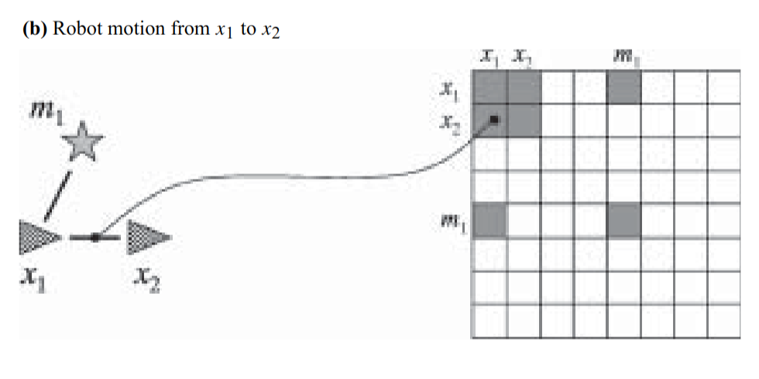
Robot Movement
Dependance Graph Information Matrix

Slide 11
Robot Movement
Constraint:
: function governing the robot's state transition
: control asserted between time t-1 and time t
: noise in the control command -
: covariance of the motion noise

Slide 12
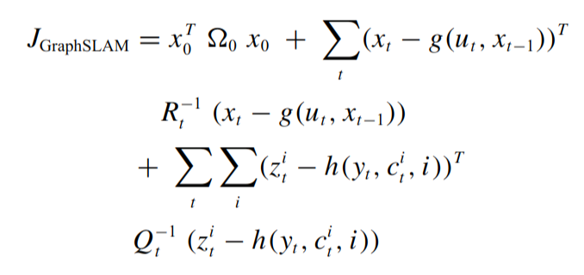
Sum of All Constraints:
: anchoring constraint that initializes the first pose as

Slide 13
Matrix Reduction
QUESTIONS?

Slide 14
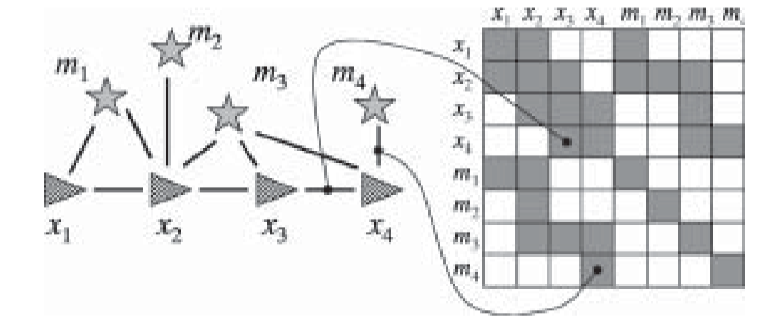
Matrix Reduction via Factorization Trick
Suppose you'd like to remove a feature,
In our spring mass model, remove a mass and replace with equivalent springs

Slide 15
Matrix Reduction via Factorization Trick
Connections between poses are changed
Some connections between non-consecutive poses may be added
In this example the removal of and is trivial
We now have a much simpler yet equivalent information matrix

Slide 16
Recover Feature Locations
QUESTIONS?

Slide 17
Recovering the Feature Locations
Builds a new information matrix and vector, and , for each feature,
These contain the original links for but the robot poses are set to the new values in but without uncertainty
. v then contains only elements that connect to

Slide 18
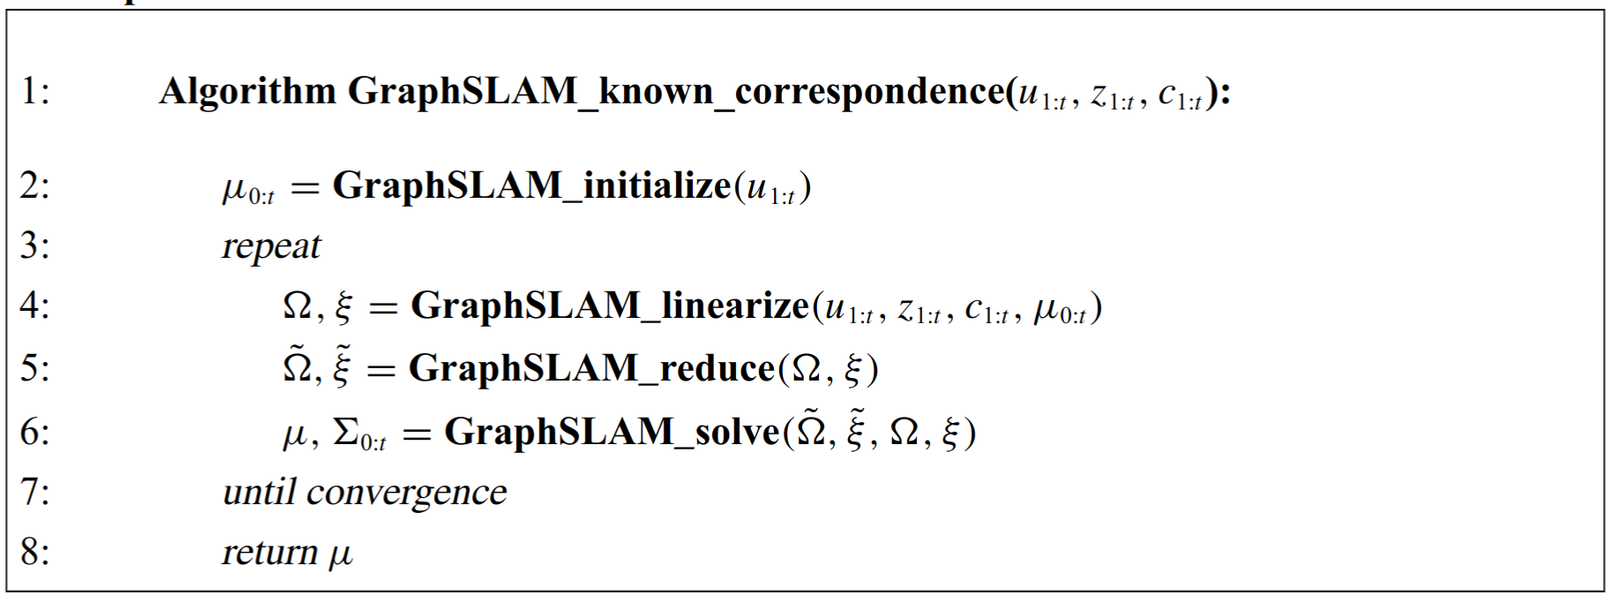
The Algorithm
Outline:
Graph-SLAM_initalize
Graph-SLAM_linearize
Graph-SLAM_reduce
Graph-SLAM_solve
Given commands, , feature measurements, , and correspondences,

Slide 19
Graph-SLAM_initalize
INPUT:
OUTPUT:

Slide 20
Graph-SLAM_initalize
In order to linearize the information matrix we need an initial estimate, , for all poses,
Initializes the first pose as (0, 0, 0)
Estimates the following poses using the motion model from the commands,

Slide 21
Graph-SLAM_linearize
INPUT:
OUTPUT:

Slide 22
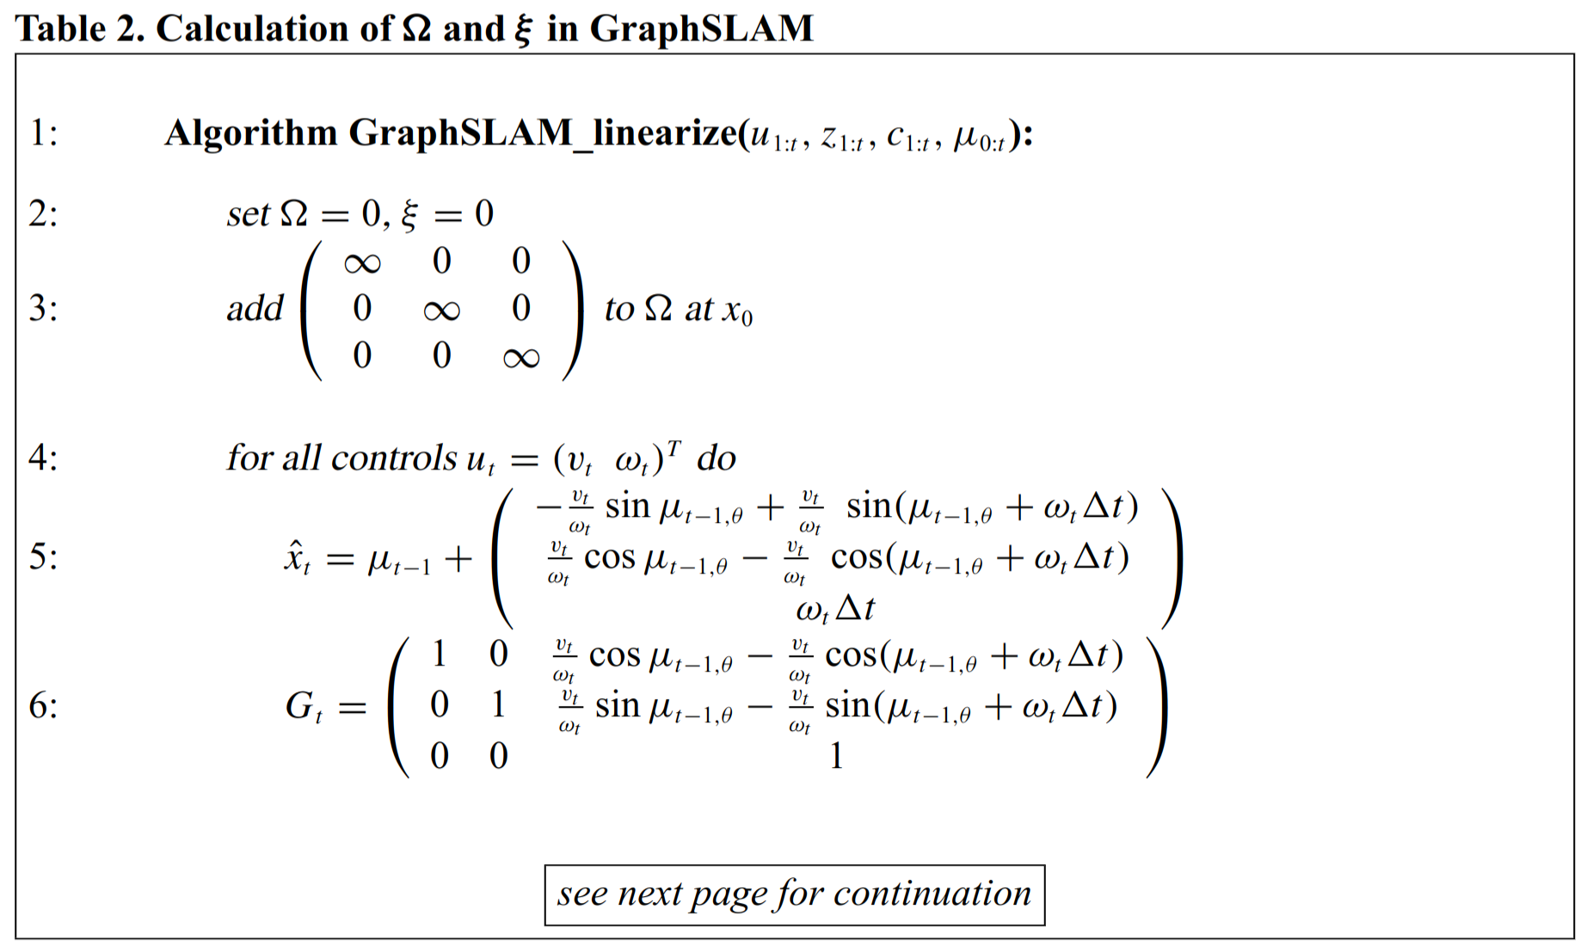
Graph-SLAM_linearize (1/2)
Initializes the information elements: the "infinite" information entry in line 3 fixes the initial pose, , to (0, 0, 0)
Controls, , are integrated in lines 4 – 9:
Pose, , and Jacobian, , are a linear approximation of measurement function, g
Information matrix and vector are updated according to this constraint

Slide 23
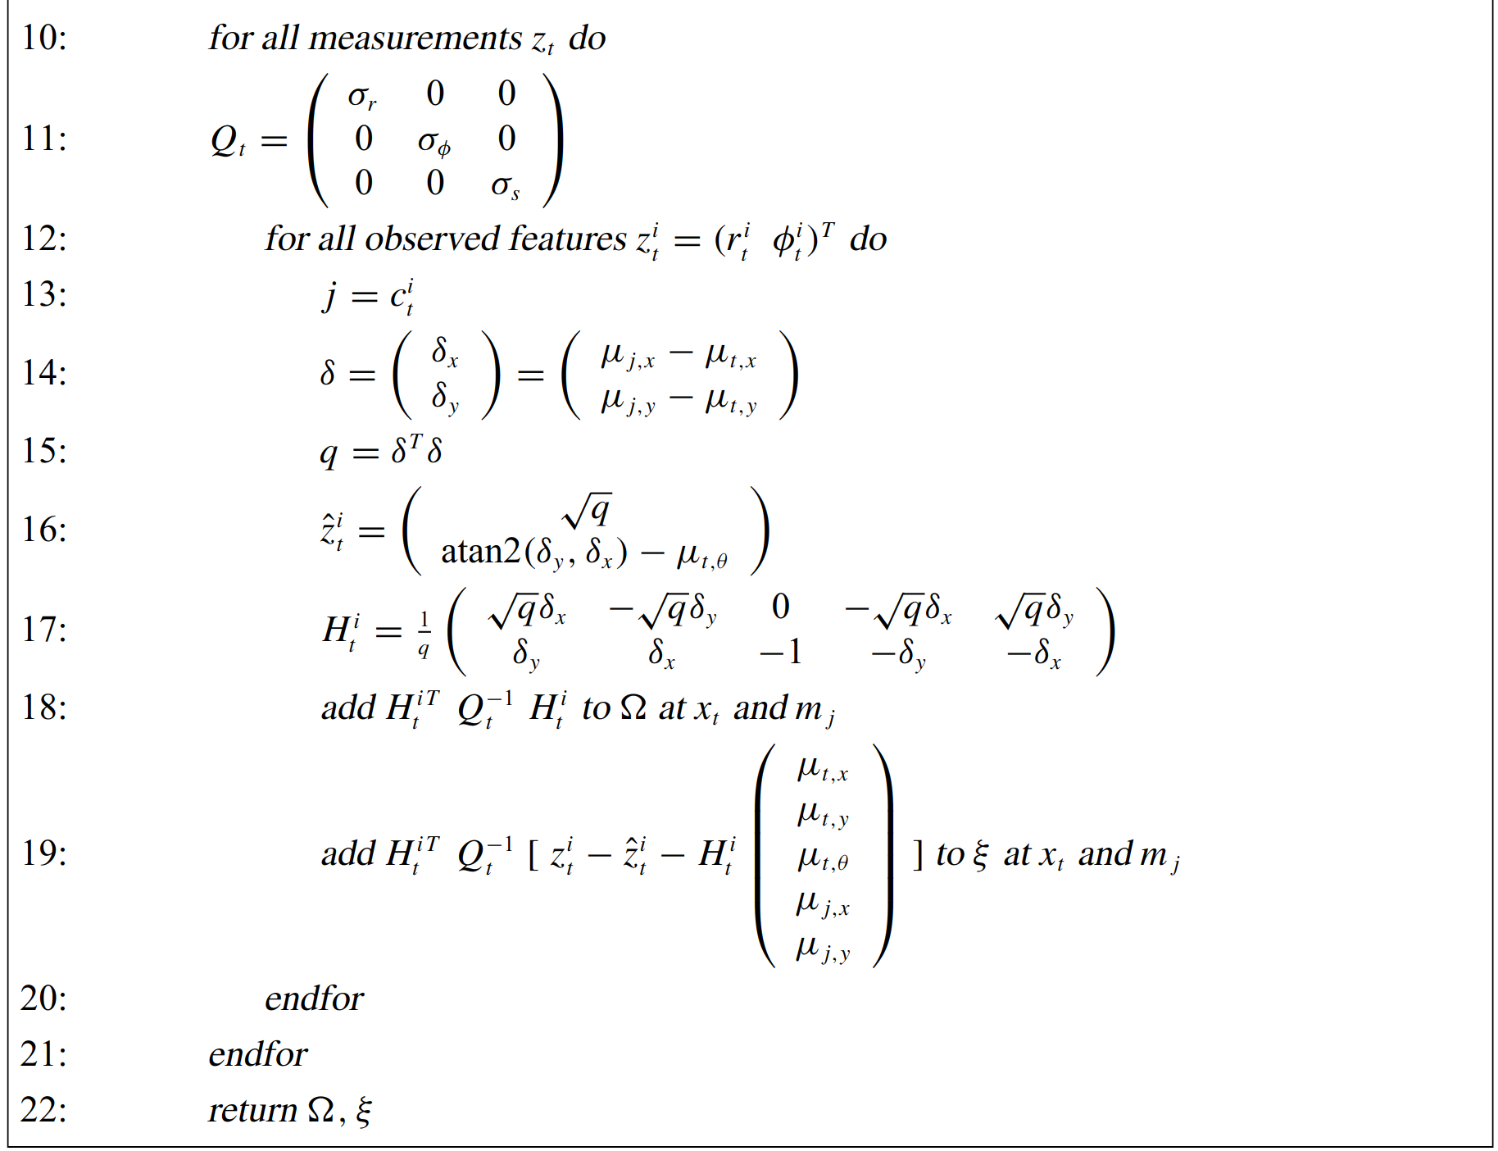
Graph-SLAM_linearize (2/2)
Feature measurements, , are integrated in lines 10 – 21:
Measurement noise covariance matrix
Lines 13 – 17 compute the Taylor expansion of the measurement function
Information matrix and vector are updated according to this constraint in lines 18 and 19

Slide 24
Graph-SLAM_reduce
INPUT:
OUTPUT:

Slide 25
Graph-SLAM_reduce
Initialize
Line 5 gets all of the poses, , linked to feature j
Lines 6 and 7 adjust the matrix and vector according to the removal of feature j (creating new springs to replace the mass)
Line 8 removes the feature j (removing the mass)

Slide 26
Graph-SLAM_solve
INPUT: ,
OUTPUT:

Slide 27
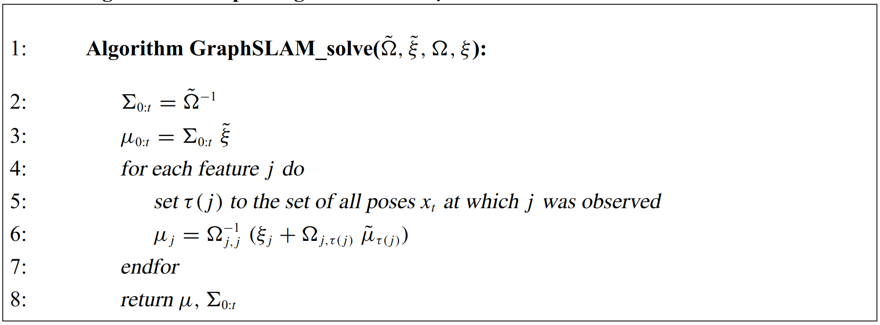
Graph-SLAM_solve
Compute the path estimates from new the information matrix and vector
Lines 4 – 7 computes the location of each feature:
Line 5 gets all of the poses, , linked to feature j
Line 6 uses the information relating to the original estimate of the feature as well as the new estimate of the robot path to calculate the location of feature j

Slide 28
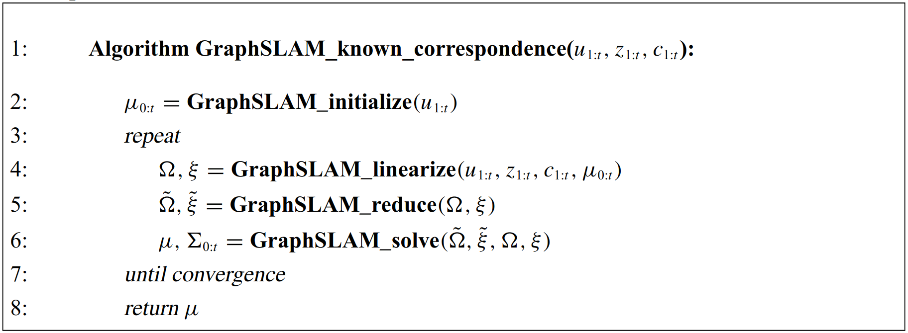
Algorithm Analysis
Initial mean estimates as calculated by GraphSLAM_initialize:
Determines the quality of the results
Has no effect on linearization of x and y components
Has an effect on linearization of orientation component
To reduce these errors in the Taylor approximation, GraphSLAM_linearize, GraphSLAM_reduce, and GraphSLAM_solve are run multiple times

Slide 29
The Derivations
Outline:
The Posterior
Taylor Expansion
Constructing the Information Form
Reducing the Information Form
Recovering the Path and the Map

Slide 30
The Posterior

Slide 31
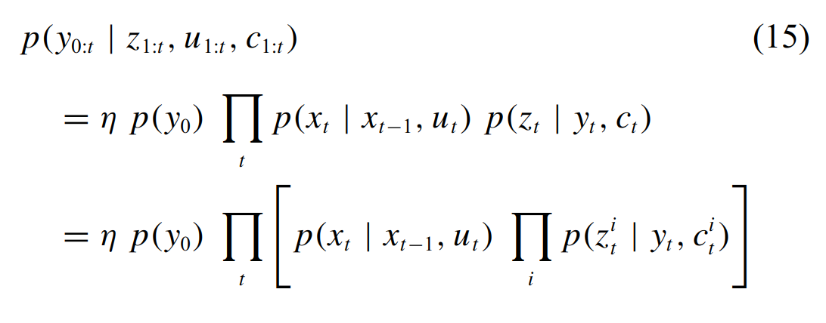
Defining the Posterior
(10) - Define y as the full state, x and m
(11) - Factor the full posterior using Bayes rule
(12) - Reduce by dropping irrelevant conditioning variables
(13) - Factor by partitioning y into x and previous y
(14) - Substitute back into (11)
(15) - Obtain closed form expression through induction over t

Slide 32
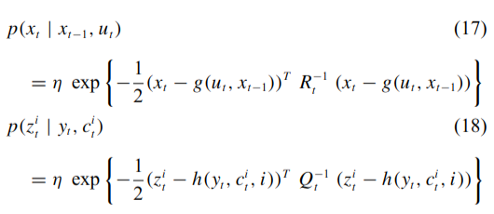
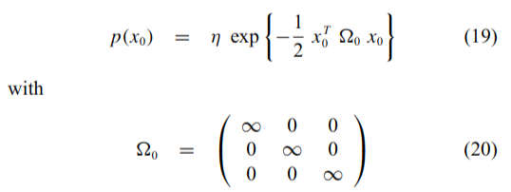
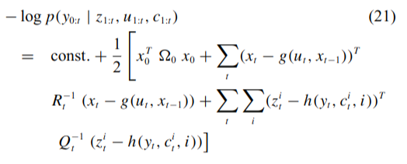
Negative Log Posterior
(16) - The information form represents probabilities in log form
(17-18) - Assume normal distribution for the robot motion and the measurements
(19-20) - Anchor initial pose to (0 0 0). Infinity can be substituted with a large positive number in practice
(21) - Quadratic form of the negative log-SLAM posterior

Slide 33
Taylor Expansion

Slide 34
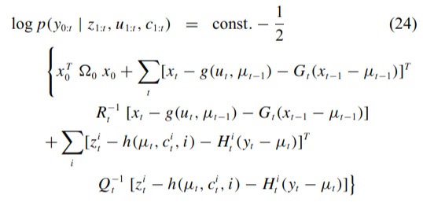
Taylor Expansion
(22-23) - Taylor Expansion applied to functions g and h in (21)
(24) - Substitute into (21) to create a function that is quadratic in y

Slide 35
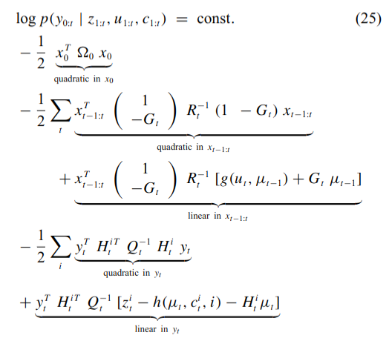
Taylor Expansion
(25) - Reorder terms, omitting several constant terms
(26) - We can collect all quadratic terms into the information matrix and all linear terms into the information vector

Slide 36
Constructing the Information Form

Slide 37
Construction
Prior: the initial pose variable and quadratic term performed in lines 2 and 3 of GraphSLAM_linearize
Controls: Each control adds one quadratic term and one linear term performed in lines 4-9 of GraphSLAM_linearize
Measurements: Each measurement adds one quadratic term and one linear term performed in lines 10-21 in GraphSLAM_linearize

Slide 38
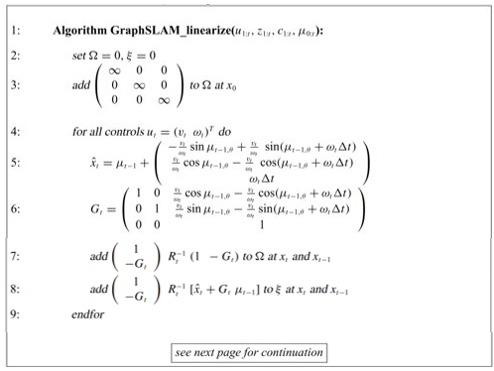
Graph-SLAM_linearize

Slide 39
Graph-SLAM_linearize

Slide 40
Reducing the Information Form

Slide 41
Reduction
(32) - Start with the factorization of the full SLAM posterior
(33) - Integrate out the map
(34) - In GraphSLAM_reduce this probability is calculated in this way
(35-36) - Subdivide the information matrix and vector into submatrices for the path and the map
(37-38) - Finding the probability according to "Marginals of a multivariate Gaussian"

Slide 42
Reduction
(39) - Calculate the matrix inversion
(40) - Fj is the sub-matrix that corresponds to the j-th feature in the map
(41-42) - using (39) and (40) to decompose (37) and (38) into a sequential update as applied in GraphSLAM_reduce

Slide 43
Graph-SLAM_reduce

Slide 44
Recovering the Path and the Map

Slide 45
Recovering the Features
(43-44) - The mean and variance of the robot path
(48) - The map probability can be decomposed into the probability of each map feature
(49-50) - The mean and variance of each map feature is calculated

Slide 46
Graph-SLAM Kalman Filter Comparison
Outline:
Probabilistic Approach
State Model
Linearization
Optimization Type

Slide 47
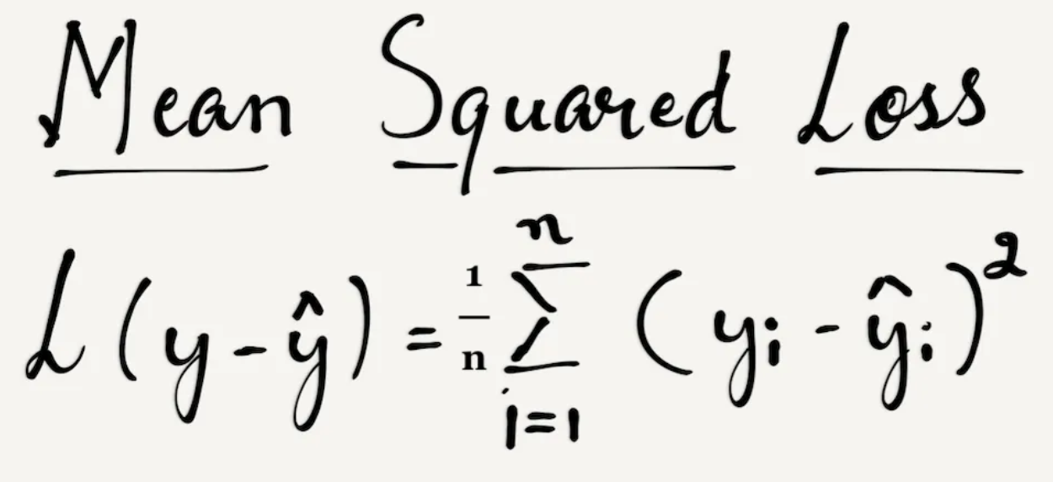
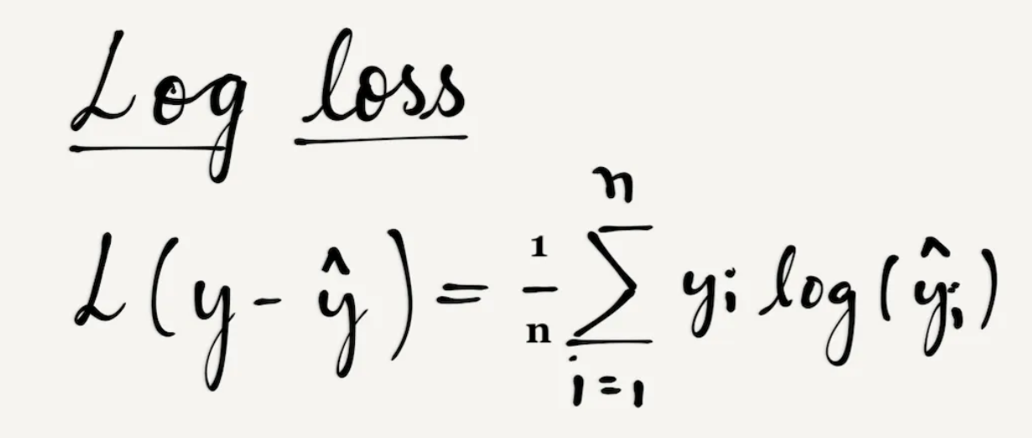
Probabilistic Approaches:
Kalman Filter : Bayesian filter
Mean of the Posterior Distribution
Minimizing the error terms : Least Squares Loss vs Log Loss
https://towardsdatascience.com/why-not-mse-as-a-loss-function-for-logistic-regression-589816b5e03c

Slide 48
State Model:
Robot pose dependant on previous pose and command
Observation (feature) measurement dependant on dependant on current pose
Gaussian noise

Slide 49
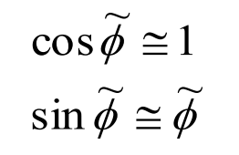
Linearization:
Requires a linear system
Methods of Linearization:
Small angle approximation
Taylor expansion

Slide 50
Optimization Types:
Kalman Filter
Graph-Slam
Iterative Optimization
Propagate – Update – Repeat
Can only guarantee local minimum
Particularly problematic for systems with relatively small noise levels
Sacrifices precision for efficiency
More effective for live/online SLAM
Precision differences decreases when linearization point is accurate
Global Optimization
Insightful visualization of the problem
Analyzes all time steps at once, building matrix of all information
Able to guarantee global minimum
Sacrifices efficiency for precision
Better handles arbitrary interconnections
C. Cadena et al., "Past, Present, and Future of Simultaneous Localization and Mapping: Toward the Robust-Perception Age," in IEEE Transactions on Robotics, vol. 32, no. 6, pp. 1309-1332, Dec. 2016, doi: 10.1109/TRO.2016.2624754.

Slide 51
QUESTIONS?

